Slide 1
Exponents & Decibels
By Warren Paulson
VE3FYN
28 February 2012
Version 1.0

Slide 2
Magnitude
We deal with both very large and very small numbers, often in the same circuit.
  A resistor may be 220,000 ohms.
  A capacitor may be 0.000000047 farads.
  A radio frequency may be 147,000,000 Hertz.
We prefer numbers between 1 and 100.
  Which is easier to understand:
  “It’s 150 kilometres to Fort Frances,” or
  “It’s 150,000 metres to Fort Frances.”

Slide 3
Making Numbers Manageable
To handle large numbers, we use multipliers.
  They are always multiples of 1000.
  100,000 metres is better expressed in KILOmetres.
  A kilometre is 1000 metres long.
  So, 100,000 / 1000 = 100 kilometres .
Likewise a millimetre is 1/1000 of a metre.
  So, 0.005 metres * 1000 = 5 mm (move the decimal).

Slide 4
Metric Units (really SI)
Small numbers
Large Numbers
To change to larger units, divide.
So, 2,200 ohms / 1000 =
2.2 kilo ohms, or 2.2 KΩ.
To change to smaller units, multiply.
So, 0.345 amps x 1000 =
345 milliamps, or 345 mA.
Name |  | Value
milli | m | 1/ 1,000
micro | µ | 1 / 1,000,000
nano | n | 1 / 1,000,000,000
pico | p | 1 / 1,000,000,000,000
Name |  | Value
Kilo | K | 1,000
Mega | M | 1,000,000
Giga | G | 1,000,000,000
Tera | T | 1,000,000,000,000
To change to smaller units, multiply.
So, 1.3 Gigahertz / * 1000 =
1,300 Megahertz, or 1,300 MHz.
To change to larger units, divide.
So, 4,700 picofarads / 1,000,000 =
0.0047 microfarads or 0.0047 uF.
Note:
Lowercase is used.
Multiples of 1,000 are used.
They are in alphabetical order.
Note:
Uppercase is used.
Multiples of 1,000 are used.
They are not multiples of 1024
unlike computers, which use base 2.

Slide 5
Exponents
We can express any number multiplied by itself using exponents.
2 x 2 x 2 becomes 2³.
We read this as:
“two to the power of three.”
On most calculators, enter: “2 y^{x} 3” or “2 y^{x} 3”.
Practice this on your own calculator,
so you know how to do it for the test.

Slide 6
Base 10 Exponents
Less than one
Greater than one
Number | Exponent
0.1 | 10⁻¹
0.01 | 10⁻²
0.001 | 10⁻³
0.0001 | 10⁻⁴
0.00001 | 10⁻⁵
We’re counting the decimal shift.
Number | Exponent
1 | 10⁰
10 | 10¹
100 | 10²
1000 | 10³
10000 | 10⁴
We’re really just counting the zeroes.
Note: a negative exponent is just smaller than one; it doesn’t represent a negative number.

Slide 7
Scientific Notation (big numbers)
Start with a big number: 147,120,000.
Move the decimal point to the left until you get a number between one and ten, and keep count.
1 . 4 7 1 2 0 0 0 0
Write as 1.47 x 10⁸, where ‘8’ is the number of positions you moved the decimal.
On your calculator, it’s: “1.47 {Exp} 8”.

Slide 8
Exponential Change
Change is often exponential.
If you double the speed of your car,
your braking distance quadruples.
To get a noticeable increase in audio output,
you need to double the signal strength.
  To get another noticeable increase, you need to double it again → what sounds like an incremental change is really a doubling of the sound level.

Slide 9
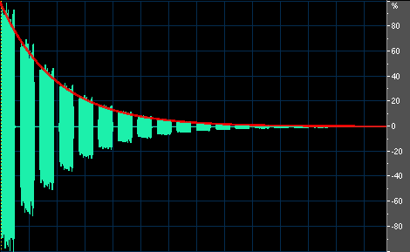

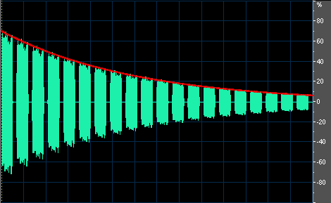
Audio Level Example
3 dB Change
In this audio clip, white noise is decreasing in 3 dB increments. That is to say that each change represents half the previous power.
1 dB Change
In this audio clip, white noise is decreasing in 1 dB increments. That is to say that each change represents about 3/4 the previous power.
Source: http://www.animations.physics.unsw.edu.au/jw/dB.htm#soundfiles

Slide 10
Exponential Growth

Slide 11
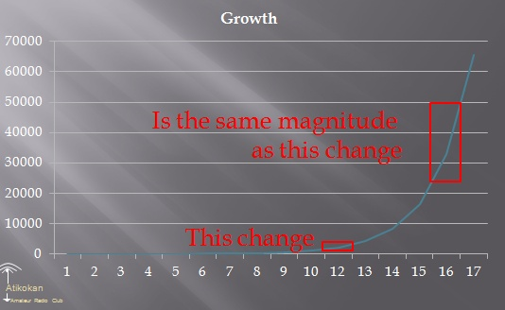
Magnitudes of Change
The first is a doubling from 2048 to 4096.
The second is a doubling from 16,248 to 32,768.
The 2048 unit increase in the first case is meaningless in the second.
There are many cases, such as audio levels or receiver input levels, where each doubling represents the smallest meaningful magnitude of change.
So, we need a numbering system where this
is the same as this.

Slide 12
Magnitudes of Change (2)
There’s another problem...
The strongest signal your radio receives could be 2.5 billion times* stronger than the weakest.
We need a numbering system that deals with this in a meaningful way.
* Most S-meters go to 40 dB over S9. Each S-unit = 6 dB,
so the total range is 54 dB + 40 dB, which is 94 dB.

Slide 13
The (dreaded) Decibel (1)
Exponents manage these magnitudes of change.
Consider 10³ = 1,000.
Increase that to 10⁶, and we have 1,000,000.
  That’s 1000 times greater.
This is the basis of the decibel.
Our exponent has only
increased by a manageable
three units.

Slide 14
The Decibel (2)
A decibel is not an absolute measure.
It always represents a power ratio between two levels (usually a reference level).
  If your amplifier has 8 dB gain, its output is 8 dB stronger than its input.
  An antenna with 6 dB gain is 6 dB more sensitive (in the desired direction) than a reference antenna.
  An audio level of 3 dB is 3 dB stronger than a reference level of 20 micropascals.
Notes:
3 – it can be expressed in terms of gain or loss.
4 – the math (1 and 2)
5 – how to add and subtract decibels
6 – the cheat

Slide 15
First, the Bel
A Bel (developed by Bell Labs), is the power that 10 must be raised to, to give us our number.
So, if we double our power output , the question is: 10? = 2. (Enter ‘2 log’ on your calculator).
‘Log’ calculates the base-10 exponent required to get our number.
The answer is roughly 0.3.
So doubling our power is 0.3 Bels.

Slide 16
Finally, the Decibel (1)
Since decimals are a pain, the Decibel simply multiplies the Bel by 10. Its short-form is dB.
If we are measuring power,
dB =10 * Log(b/a)
where a is input power and b is output power,
or a is reference power and b is measured power.
Note: The Bel is a seldom used unit for this reason,
and is only shown to explain how the dB is derived.

Slide 17
Finally, the Decibel (2)
So, if our amplifier puts-out 80 watts with 10 watts in, that’s:
10 * Log (80/10), or 10 * Log(8) = 9 dB
Always round decibels to the nearest unit.

Slide 18
Decibels with Voltage
When dealing with weak input signals, we often work in Volts (energy) not Watts (power).
Since dB is a power ratio, we need to convert voltage to power:
Since doubling the voltage quadruples the power, it’s:
dB = 20 * Log(b/a)

Slide 19
Suffixes
dB is often followed by a suffix that indicates the reference.
  dBi = gain relative to an imaginary isotropic antenna that radiates equally in all directions.
  dBd = gain relative to a dipole antenna.
  (0 dBd =2.15 dBi)
  dBm = gain relative to a milliwatt.

Slide 20
Adding and Subtracting
1.Gain:
Just add and subtract all the gains/losses.
6 dB – 2 dB = 4 dB
The total gain at the antenna is 4 dB
2.Effective Radiated Power:
To convert dB to a ratio, divide it by ten, then raise 10 to that power:
10 {Y^{x}} 0.4 = 2.5
So the output power (ERP) will effectively be 2.5 times the input power, in the desired direction.
100 * 2.5 = 250 watts ERP
Let’s say we have:
  A 100 watt transmitter.
  A feedline with 2 dB loss over its length.
  An antenna with 6 dB gain.
What is the actual gain at the antenna?
What is the effective radiated power at the antenna?

Slide 21
Shortcuts (1)
The table to the right gives the most common decibel values you need to know, and is easy to memorize.
Power | Decibels
2 | 3
4 | 6
6 | 8
8 | 9
10 | 10
100 | 20
1000 | 30

Slide 22
Shortcuts (2)
The tens (the 3 in 38) place the decimal point, being the multiplier.
The units (the 8 in 38) are the actual value.
So 38 dB is a ratio in the 1000's and since the log of 8 is 6, it is 6000.
Example, 38 dB
  30 is the multiplier
  08 is the value
30 = thousands
08 = 6
Therefore:
38 dB = 6000
Contributed by VE3LPX

Slide 23
End
73

